Slide 1
ERP Recommendations
Production & Maintenance
21 July 2020

Slide 2
Improvement Areas
Inventory Receipt Process
Assembly Process & BOM
Field Maintenance
Performance Tracking & Management

Slide 3
Inventory Receipt Process
PROBLEM STATEMENT
The inventory receipt process is manual, heavily reliant on user and there is a significant amount of time between time of inventory receipt to time of warehouse/bin stocking. Summary of steps taken
Manual typing & printing of parts serial numbers at the time of inventory receipt
Manual tagging of parts with the printed serial numbers
Manual ERP GRN creation (typing serial numbers into the GRN)
Poor shelf life of serial numbers stickers
These steps results to
Delayed inbound QC process waiting for printing & tagging of parts
Other stores operations are put on hold
High costs. It costs $0.20 per sticker or $20 per KP which is quite high
Time wastage from manual typing of serial numbers which also creates room for errors
Time wastage in validating GRN (~2 days to validate 800 serial numbers for a single part)

Slide 4
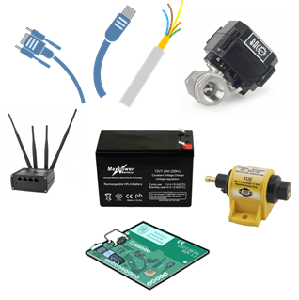
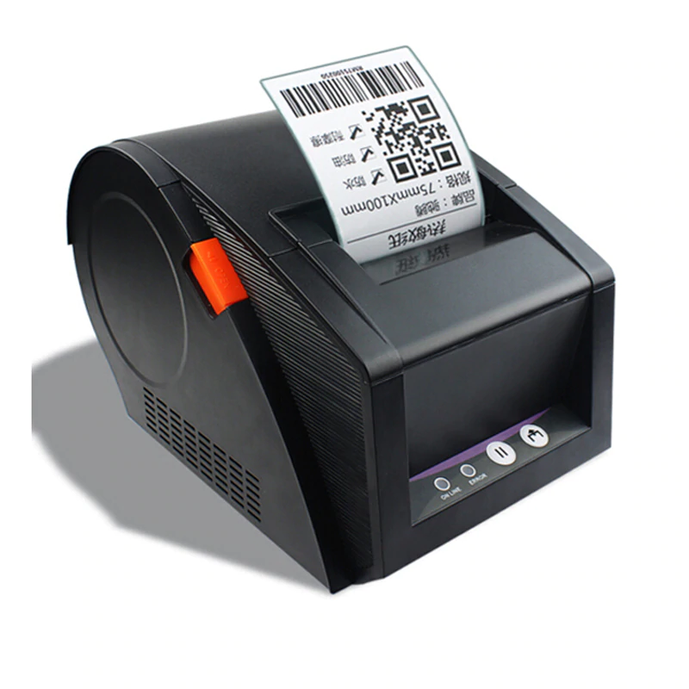
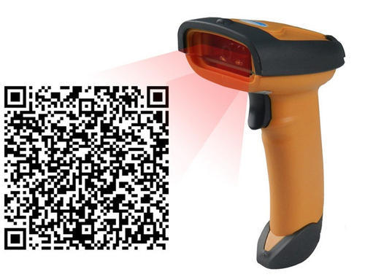
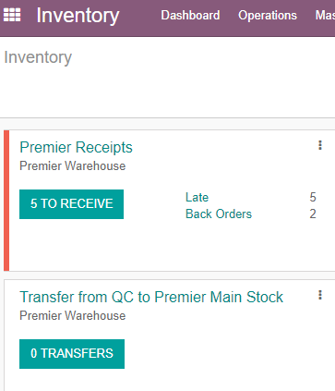
Inventory Receipt Process
VISION
Parts Receipt
Serial # Creation & Parts Tagging
GRN Creation & Part Scanning into Odoo
VALUE ADDED
Time reduction in asset tagging as there is no manual printing
Improved accuracy (100%)
Reduction in time between parts receipt and QC process
Reduction in tagging costs by X%
Good shelf life of high quality stickers that can withstand handling and other environmental conditions

Slide 5
Assembly Process & BOM
PROBLEM STATEMENT
The current assembly tracking is manual through google sheets (>60000 rows for 700 KPs) and heavily reliant on user. Summary as described below
Specific parts are issued against specific MOs which is very labour intensive
Specific MOs have to be closed against specific KOKOpoints which is again labour intensive and quite inefficient
MOs consuming the wrong BOM
Accounting & reconciliation of parts against BOM versions is non existent
Time lag for when assembly has been completed to when MO is closed (~4 months in the 1st production cycle of 700 KPs)

Slide 6
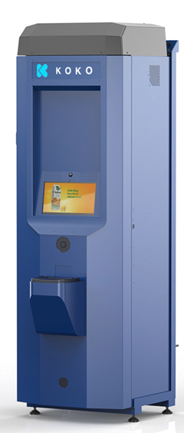
Assembly Process
VISION
Create MO
Issue & Scan Parts Out Against MO
Scan Parts Assembled and Close MO
Assemble KP
VALUE ADDED
Simple and less labour intensive. Any part can go to any KP
More accurate and MOs are closed out in a timely fashion
First stage of assembly QC is auto completed
Efficient. Cycle time reduced by X%
Real time tracking & reporting of BOM versions against respective KPs

Slide 7
Field Maintenance
PROBLEM STATEMENT
Current maintenance module is not fit for purpose for field operations. Highlights are
Rigid system. Specific parts have to go to specific KOKOpoints
Responsibilities don’t lie with the right users
It is labour and time intensive

Slide 8

Field Maintenance
VISION
Remove and Scan Parts
Add and Scan Parts
VALUE ADDED
Real time update and accountability of inventory
Automatic receipt to Defective Items Location of the removed parts. Ease of tracking from stores team as they'll just need to validate quantities returned against what was removed
Not labour intensive and responsibilities lie with the right users
Any part can go to any KP

Slide 9
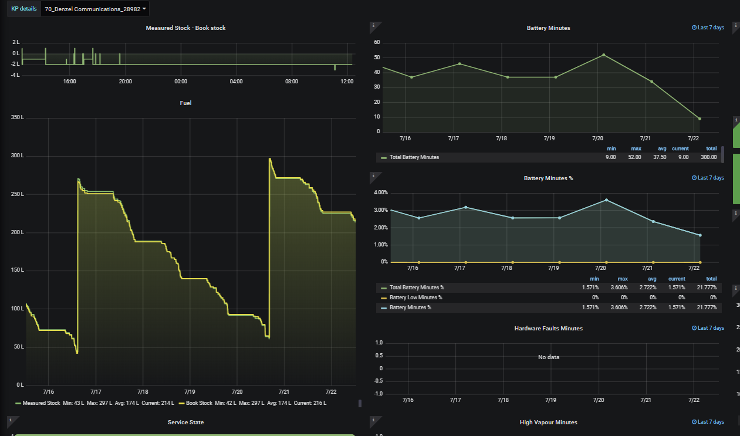
Performance Tracking & Analysis
PROBLEM STATEMENT
Absence of end to end tracking of parts since the respective processes are managed manually with a number of gaps. Once a KP has been assembled, that’s the end of the tracking and we are not in a position to know replaced parts and when it was done
VISION
End to end tracking of parts
VALUE ADDED
Systemizing the production and maintenance processes generates value in performance analysis of parts

Slide 10

Thank you

